Slide 1

DFS Installation and configuration in windows server 2016
Presentation Subtitle
Notes:
1

Slide 2

Outline
What is DFS?
How does DFS Work?
Advantage of DFS
Disadvantage of DFS
Application of DFS
Notes:
2

Slide 3

What is DFS
(DFS) is the abbreviation of the distributed file system.
Which is a file system that store data on a server
Through DFS, you can easily share information and files between users on the network in a controlled and authorized manner.
Notes:
3

Slide 4


How does DFS work
Standalone DFS namespace.
Domain-based DFS namespace
Notes:
4

Slide 5
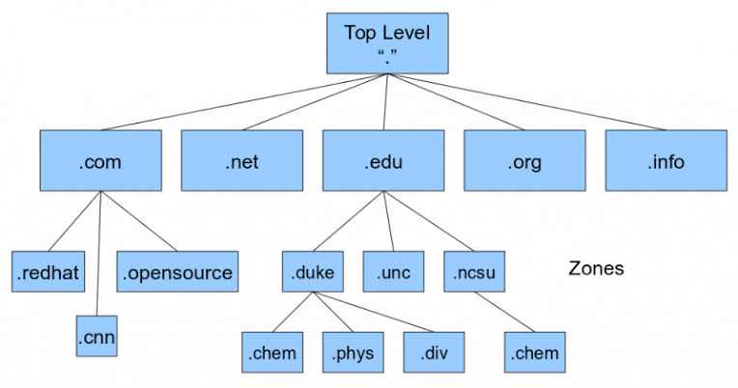
Domain-based DFS namespace
Use Active directory
Support multiple root
Standalone DFS namespace:
Don’t use Active directory
Support single root
Notes:
5

Slide 6

Advantage of DFS
It allows multiple user to access or store data
It allows remote sharing of data
It improve the ability to exchange data
Even if the server or disk fails, the DFS can provide data transparency.
It improves file availability, access time and network efficiency.

